Slide 1

Reclaim with AI

Slide 2

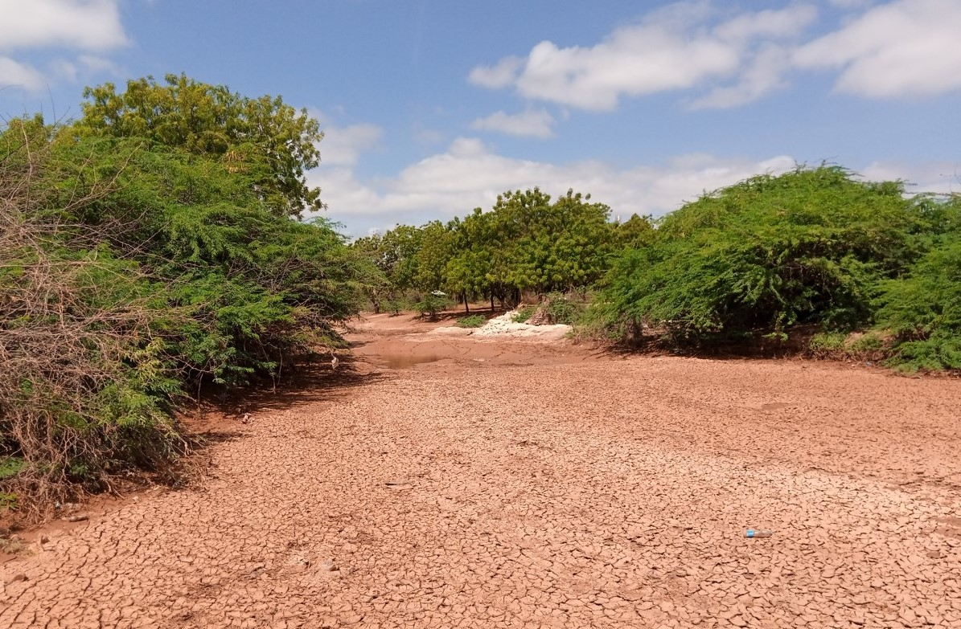
Mathenge: The land Hungry Invader
Biodiversity Loss: Suppresses native vegetation, reducing pasture and destroying wildlife habitats
Soil and Water Depletion: Deep roots aggressively compete for groundwater, lowering water tables.
Land Degradation: Converts once-productive farmland and grazing lands into uninhabitable bushland.
Manual mapping is slow, leading to blind budgets and restoration efforts that start too late.

Slide 3
Why EcoSiren
1. Trained AI
2. Display Risk
3. Enable Action
Sentinel-2 pixels flag Mathenge at 15-30m resolution.
Green-red risk map consistently updates
Counties see exact hectares, plan removal, track regrowth.
100× faster than field walks. Nationwide coverage from day one. No expert needed.

Slide 4
Model , System and Prototype
Antugrow + Kefri data
sources
MULTI-API integration
architecture
Priority zone ranking
algorithms

Slide 5
Impacts and scaling
Phase 1: Local Beachhead
Phase 2: Scale & Replicate
Target 2 counties; Garissa & Tana-River.
Link the government, NGOs and local people to the data.
Scan, detect, Reclaim
Replicate kit to other invaded counties.
Creating job opportunities for the youth.
Monetization of invasive plants.

Slide 6
Who are we
Iqra Hussein
Khadija Ali
Researcher, Front-end Developer
Geospatial Analyst, Front-end Developer
Mark Mariga
Greg Enos
Graphic designer, Front-end developer
Backend Developer
Engineering team

Slide 7
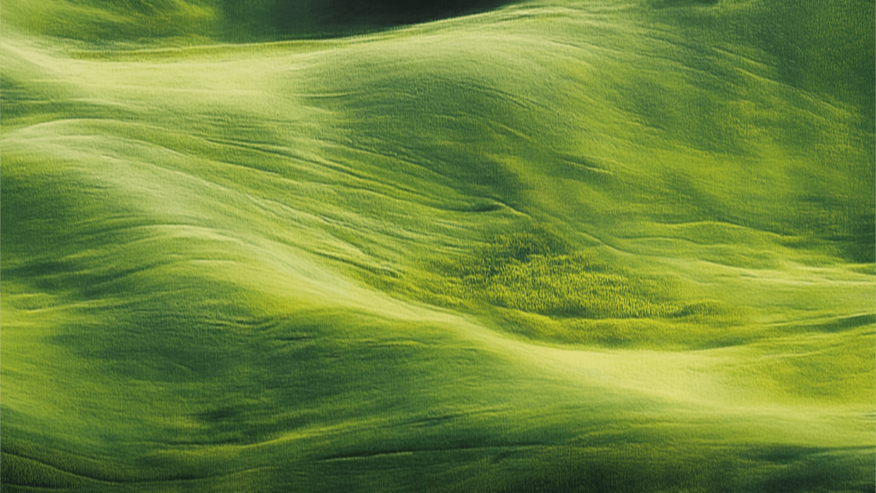
THANK YOU

